Slide 1
CAS – Creativity Activity Service Involving students in enjoyable and significant experiences
CAS Coordinator
Ginny Bineypal Hatlemark

Slide 2
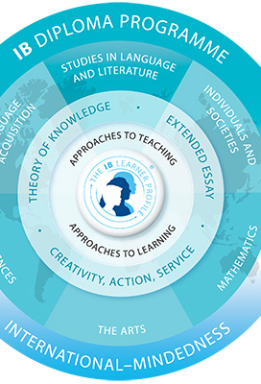
What is CAS?
The three Strands - Creativity Activity and Service
CAS is part of the core, together with TOK and EE
CAS is mandatory
Students need to pass CAS in order to complete the diploma program and get the IB diploma.
CAS is the non- academic part of the IB diploma program.
ManageBac is the digital platform for CAS.

Slide 3
The I.B. Learner Profile and CAS
I.B. participants strive to be
inquirers
knowledgeable
thinkers
communicators
principled
open-minded
caring
risk-takers
balanced
reflective

Slide 4
Aim of CAS
To help students develop the characteristics of the Learner Profile
To help students to learn through doing: Experiential Learning

Slide 5
The Nature of CAS: Strand 1
Creativity: exploring and extending ideas leading to an original or interpretive product or performance. This may include visual and performing arts, digital design, writing, film, culinary arts, crafts and composition.

Slide 6
Creative CAS Experiences
The Book Club → Wednesdays, contact-teacher hour
MUN (also service) → Thursdays, after school
The Coding Club → online
Band → Wednesdays, after school
Drama Club
Painting
Singing
Playing a musical instrument

Slide 7
Activity
Activity: physical exertion contributing to a healthy lifestyle
Pursuits may include individual and team sports, aerobic exercise, dance, outdoor recreation, fitness training, and any other form of physical exertion that purposefully contributes to a healthy lifestyle.

Slide 8
Activity CAS Experiences
Hiking
Jogging
Taekwondo
Training at the gym
Volleyball
Skiing/Snowboarding
Activity day

Slide 9
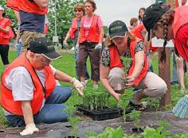
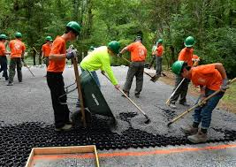
Service
Service: Collaborative and reciprocal enagement with the community in response to authentic need.
Community-based:
Class project – Nesbru Nursing Home
Plan International – staff lunches at school
School-based:
Lunch with TO → Tuesdays, Thursdays
Language teaching / helping VO
Picking up garbage → Sundays
Making and celling bracelets to support cancer research

Slide 10
How to CAS
Plan and have experiences that represent Creativity, Activity and Service
Experiences should demonstrate the Learning Outcomes and documented on ManageBac
Experiences
Single experiences
Series of related experiences
CAS projects: collaborative, long-term (minimum 1 month)
Recorded in the CAS Portfolio (Managebac)

Slide 11
CAS Experiences
PLAN → ACT → OBSERVE → REFLECT→RECORD
(Repeat often)

Slide 12
Role of the supervisor
To be familiar with elements of the CAS programme as applicable. Ask the CAS coordinator.
To be responsible for student’s safety and risk management procedures, if applicable.
provide students with guidance, support and feedback on the CAS experience.
encourage students to write reflections.
Encourage students to update CAS portfolio on ManageBac
comment on the student’s engagement with the CAS experience in the completion form.

Slide 13
Students and teachers get to know each other better
You get to know each other people outside of school
You get to see a different side of us
It's super fun
You will feel young again
You will be motivated to do the same
Some of the projects could be your own as well

Slide 14
Thank you!

